Slide 1
Acceptance Testing with Fitnesse
Alessandro Marchetto
Fondazione Bruno Kessler - IRST

Slide 2
Outline
- Table-based acceptance Testing
- Fit/Fitnesse for Java
The next lesson will be a laboratory...
...Please remember your pc:
    Eclipse
    Fitnesse plugin http://www.bandxi.com/fitnesse/index.html
      http://www.bandxi.com/fitnesse/com.bandxi.fitnesse_v1.0.2.zip

Slide 3
Testing tools
Jemmy/Abbot/JFCUnit/…
FIT/Fitnesse (High level)
GUI
Perfomance and
Load Testing
JMeter/JUnitPerf
Cactus
Business
Logic
HttpUnit/Canoo/Selenium
Junit (Low level)
Web UI
Persistence
Layer
Junit/SQLUnit/XMLUnit

Slide 4
Traditional Approaches for acceptance testing
Manual Acceptance testing. User exercises the system manually using his creativity.
Acceptance testing with “GUI Test Drivers” (at the GUI level). These tools help the developer do functional/acceptance testing through a user interface such as a native GUI or web interface. “Capture and Replay” Tools capture events (e.g. mouse, keyboard) in modifiable script.
Disadvantages: expensive, error prone, not repeatable, …
Disavantages:
Tests are brittle, i.e., have to be re-captured if the GUI changes.
“Avoid acceptance testing only in final stage: Too late to find bugs”

Slide 5
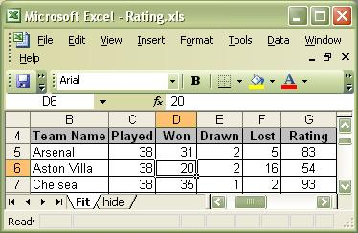
Table-based Approach for acceptance testing
Starting from a user story (or use case or textual requirement), the customer enters in a table (spreadsheet application, html, Word, …) the expectations of the program’s behavior.
At this point tables can be used as oracle. The customer can manually insert inputs in the System and compare outputs with expected results.
inputs
output
Pro: help to clarify requirements, used in System testing, …
Cons: expensive, error prone, …

Slide 6
What is Fit?
The Framework for Integrated Test (Fit) is the most well-known implementation (open source framework) of the table-based acceptance testing approach.
Fit lets customers and analysts write “executable” acceptance tests using simple HTML tables.
Developers write “fixtures” to link the test cases with the actual system itself.
Fit compares these test cases, written using HTML tables, with actual values, returned by the system, and highlights the results with colors and annotations.

Slide 7
Using Fit
Just two steps are required to automate user acceptance tests using Fit:
Express a test case in the form of a Fit table.
Write the glue code, called a Fixture, that bridges the test case and system under test.
That's it!
You are all set to execute the tests automatically for the rest of the application’s lifetime.

Slide 8
To work with Fit
To work with Fit, you must know and understand three basic elements:
  Fit table
  Fixture
  Test runner

Slide 9
Fit table
A Fit table is a way of expressing the business logic using a simple HTML table.
Fit tables help developers better understand the requirements and are used as acceptance test cases.
Customers and Analysts create Fit tables using a tool like Word, Excel, or even a text editor.

Slide 10
Fixture
A fixture is an interface between the test instrumentation (in our case, the Fit framework), test cases (Fit tables), and the system under test.
Fixtures are procedures/functions/classes usually written by developers.
In general, there is a one-to-one mapping between a Fit table and fixture.

Slide 11
Test Runner
The Test runner compares the customer-set expectations with the actual results and reports any errors by color-coding the table rows.
sample.VerifyRating
team name
played
won
drawn
lost
rating()
Arsenal
38
31
2
5
83
Aston Villa
38
20
2
16
54
Chelsea
38
35
1
2
93
Dummy
38
35
1
2
100 expected
-------------------
93 actual
Wigan
38
26
7
5
75
“red for failures and green for passed tests”

Slide 12

The Fit picture
Output Table
o ≠ o’
Developer
Test Runner
Fixture
o’
i
Customer/
Analyst
(i, o)
System
User Story
Fit Table
O = expected output
O’ = actual output

Slide 13
Core Fixture
Fit provides three core fixtures:
Column fixture for testing calculations.
Action fixture for testing the user interfaces or workflow.
Row fixture for validating a collection of domain objects. Used to check the result of a query.
Other fixtures are:
Summary fixture to display a summary of all test on a page.
RowEntry Fixture to add data to a database or to call a function with different inputs
Html fixture to examine and navigate HTML pages.
Table fixture, Command line fixture, …

Slide 14
Fit Tools
Fit - http://fit.c2.com/wiki.cgi?DownloadNow (Java, C++, …)
FitRunner - http://fitrunner.sourceforge.net/ (eclipse plug-in).
StoryTestRunner - GUI for running Fit tests written with .NET
FitNesse - http://www.fitnesse.org (Java, C#, C++).
“Other Fit tools for”: .Net, Python, Perl, SmallTalk, C++, Ruby, Lisp, Delphi, etc.

Slide 15
What is a Wiki?
Wikipedia …
A minimalist Content Management System.
Everyone can change every page.
Changes are visible immediately.
There are abbreviations for often used HTML tags.
Whenever a word is combined of several others (TestDrivenDevelopment), it becomes a link to a new page. When the link is activated the first time, you can fill the empty page.
TestDrivenDevelopment?

Slide 16
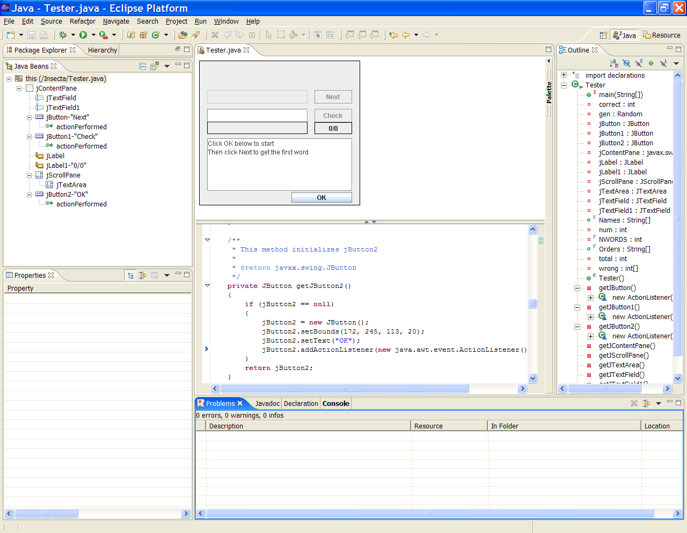
Eclipse
IDE = “Integrated development environment”
Eclipse is mostly known as a Java IDE.
Thanks to its open architecture, Eclipse is wide open to extensions.
  Plug-ins
Other languages and tools are being integrated in the platform.
http://www.eclipse.org/
writing programs
executing programs
debugging programs
…

Slide 17
What is FitNesse?
A collaborative testing and documentation tool:
It supports Java (eclipse plug-in), .Net, C++
It combines Fit with a Wiki Web for writing “natural language requirements” + Fit tables.
It provides a simple way to run tests (Fit tables) and suits.
It Supports sub Wikis for managing multiple projects.

Slide 18
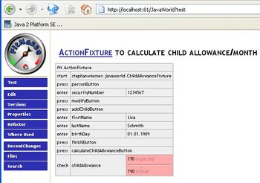
How to use FitNesse?
http://www.bandxi.com/fitnesse/download.html
Install and start.
Define the project on the FitNesse Wiki.
Write requirements and fit tables on the FitNesse Wiki.
Write the glue code (fixture), the unit tests and the business logic in your favorite IDE (eclipse).
Execute the acceptance tests by a click on the Web page (test button).
See the results (green or red) of executing the tests on the Web page.
“expected 170, actual 190”
How to use Fitnesse without Eclipse? http://fitnesse.org/FitNesse.UserGuide.DownloadingAndInstallingFitNesse

Slide 19
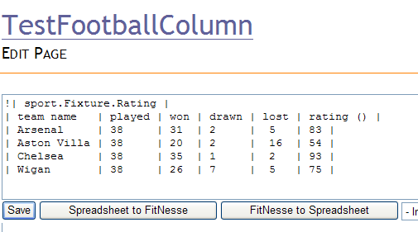
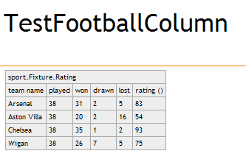
http://fitnesse.org/FitNesse.UserGuide.EditingFitNessePages

Slide 20
Sub Wikis and Test suites
A normal Wiki is a collection of pages with a flat structure. All the pages are peers.
FitNesse allows you to create Sub Wikis. Each Wiki page can be the parent of an entire new Wiki.
A Test Suite executes all tests in the sub Wiki.
…
Wiki
parent
SubWiki 1
SubWiki 2
http://fitnesse.org/FitNesse.UserGuide.SubWiki

Slide 21
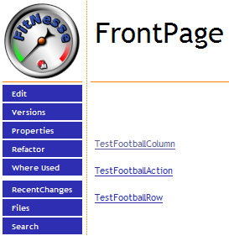
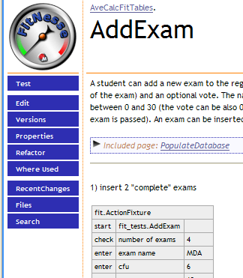
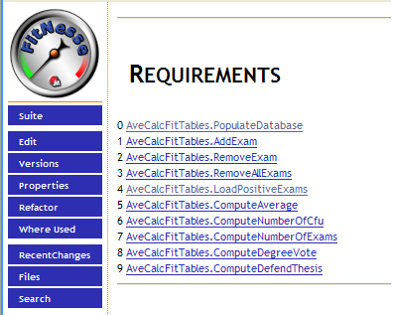
Wiki
Sub-wiki
Remember to initially create the first page

Slide 22
Core Fixture in Fitnesse
Fit provides three core fixtures:
ColumnFixture for testing calculations.
ActionFixture for testing the user interfaces or workflow.
RowFixture for validating a collection of domain objects. Used to check the result of a query.
Other fixtures are:
RowEntryFixture to add data to a database or to call a function with different inputs
HtmlFixture to examine and navigate HTML pages.
TableFixture, …
http://fitnesse.org/FitNesse.UserGuide.FixtureGallery

Slide 23
ColumnFixture
import fit.ColumnFixture
extends ColumnFixture
It maps table columns directly to properties, methods and fields of the fixture class. It is very useful for repetitive verifications if the same test needs to be repeated for different combinations of input arguments.
- The second row lists column names for input and output “()”
- All following rows list combinations of input arguments and expected values of output arguments.
!|info.fitnesse.fixturegallery.ColumnFixtureTest| |firstPart|secondPart|together()|totalLength()| |Hello|World|Hello, World|10| |Houston|We Have a Problem|Houston, We Have a Problem|24| | import fit.ColumnFixture; public class ColumnFixtureTest extends ColumnFixture { public String firstPart; public String secondPart; private int length; public String together(){ length=firstPart.length()+secondPart.length(); return firstPart+ ", "+secondPart; } public int totalLength(){ return length; } }
The fixture class should extend fit.ColumnFixture and declare public fields and methods to
match the second table row.

Slide 24
ActionFixture
import fit.ActionFixture;
extends ActionFixture
It is intended for workflow-style tests that are not repetitive.
All rows after the first begin with a command cell, followed by command arguments in the remaining cells.
Possible commands are:
start — it starts the test by taking the class name for the actual fixture to automate
check — it executes a method and verifies its value.
press — it executes a void method without testing anything.
enter — it executes a method and passes an argument to it.
!|ActionFixture| |start|ActionFixtureTest| |enter|firstPart|Hello| |enter|secondPart|World| |press|join| |check|together|Hello, World| | public class ActionFixtureTest extends fit.Fixture{ private String first, second, both; public void firstPart(String s){ first=s; } public void secondPart(String s){ second=s; } public void join(){ both=first+ ", "+second; } public String together(){ return both; } }

Slide 25
RowFixture
import fit.RowFixture
extends RowFixture
It tests dynamic lists of objects. It will compare the expected list (FitNesse table) with the actual result (from fixture code) and report any additional or missing items.
- The second row describes the properties or methods that you want to verify
- All rows after that describe expected objects in the array
!|RowFixtureTest| |name|post code| |John Smith|SW4 66Z| |Michael Jordan|NE1 8AT| | import info.fitnesse.fixturegallery.domain.Player; import fit.RowFixture; public class RowFixtureTest extends RowFixture{ public Class getTargetClass() { return Player.class; } public Object[] query() throws Exception { return Player.players.toArray(); } }
Override:
- getTargetClass: returns the Type or Class object representing the type of objects in the array.
- query: returns the actual array of objects to be verified.

Slide 26
RowEntryFixture
import fitnesse.fixtures.RowEntryFixture;
extends RowEntryFixture
It is useful for adding a bunch of data to a database or for calling a function over and over again with different arguments.
- The first row contains the field that we want to enter
- All rows after the first contain the data to be added
|fitnesse.fixtures.RowEntryExample| |v| |1| |0| | public class RowEntryExample extends RowEntryFixture{ public int v; public void enterRow() throws Exception{ if (v == 0) throw new Exception("Oh, no! Zero!"); } }
RowEntryFixture is an abstract class. You have to derive from it.
It derives from ColumnFixture and works just the same way it does.
You override the enterRow function to add your data to the database.

Slide 27
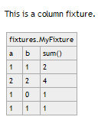
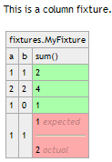
An example: Sum Calculator
public class MySum {
public static int sum (int a, int b) {
return a+b;
}
}
public class MyFixture
extends ColumnFixture {
int a,b;
public int sum () {
return MySum.sum(a,b);
}
}
A full demo:
http://softeng.polito.it/courses/tutorial/FitnesseInEclipse.html

Slide 28
An example: Football team Website
A sports magazine decides to add a new feature to its Website that will allow users to view top football teams based on their ratings.
An analyst and a developer get together to discuss the change requirements.
The outcome of the discussion is:
  a user story card that summarizes the change requirements
  a set of acceptance tests
  an excel file with sample data

Slide 29
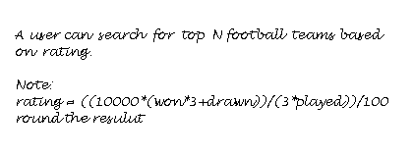
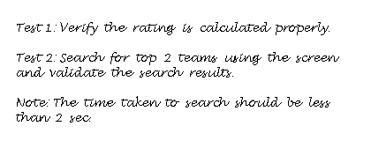
user story
(change requirement)
set of acceptance tests
excel file with sample data

Slide 30
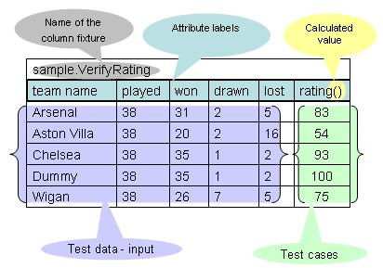
Test1: Table
“verify the rating is calculated properly”
For a team, given the number of matches played, won, drawn, and lost, we need to verify that the ratings are calculated properly.
The first step is to express the logic using a Fit table.
The table created using Excel can be easily converted into a Fit table by just adding a fixture name and modifying the labels.
The Fit table on the right represents the first acceptance test case to verify the rating calculation.
Now that we have created the Fit table, we need to write the glue code that will bridge the test case to the system under test.
“column fixture”

Slide 31
Test1: Fixture
“verify the rating is calculated properly”
For each input attribute represented by Columns 1 through 5 in the second row of the Fit table, there is a public member with the same name
A public method public long rating() corresponds to the calculation in the sixth column.
The rating() method in VerifyRating creates a Team object using the input data specified by the test case and returns the rating from the Team object; this is where the bridging between the test case and the system under test happens.
public class VerifyRating
extends ColumnFixture {
public String teamName;
public int played;
public int won;
public int drawn;
public int lost;
public long rating() {
Team team = new Team(teamName,
played,won,drawn,lost);
return team.rating;
}
}

Slide 32
The domain object representing a football team
package sport.businessObjects;
public class Team {
public String name;
public int played;
public int won;
public int drawn;
public int lost;
public int rating;
public Team(String name, int ply, int won, int drawn, int lst) {
super();
this.name = name;
this.played = played;
this.won = won;
this.drawn = drawn;
this.lost = lost;
calculateRating();
}
private void calculateRating() {
float value = ((10000f*(won*3+drawn))/(3*played))/100;
rating = Math.round(value);
}
}

Slide 33
Test1: Running
“verify the rating is calculated properly”
Launch the test runner …
Here is what happens when you run the test:
Fit parses the table and creates an instance of “sample.VerifyRating”
For each row in the table Fit set the values specified in Columns 1 through 5 to the corresponding fields in the fixture.
The rating() method is executed to get the actual value to be compared against the expected value specified in the sixth column.
If the expected value matches the actual value, then the test passes; otherwise it fails.
sport.fixtures.VerifyRating
team name
played
won
drawn
lost
rating()
Arsenal
38
31
2
5
83
Aston Villa
38
20
2
16
54
Chelsea
38
35
1
2
93
Dummy
38
35
1
2
100 expected
-------------------
93 actual
Wigan
38
26
7
5
75
passed
failed
exception

Slide 34
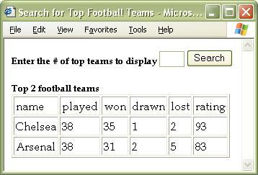
Test 2
“Search for top two teams using the screen and validate the search results”
Let’s move on to the next test case: Search for top two teams using the screen and validate the search results.
This step involves a screen (Web page) through which the user:
1) provides input
2) clicks on a button
3) seeks verification that the results returned match a collection of objects as expected.
“Top 2 teams based on rating”

Slide 35
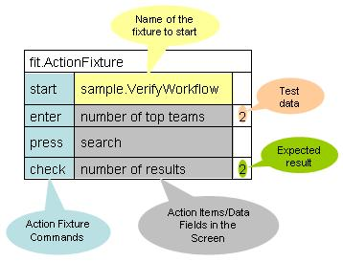
Test 2: Table 1
“Search for top two teams using the screen and validate the search results”
Testing a screen using an action fixture: the action fixture supports four commands that you can use to simulate the actions that a user would perform on a screen.
The commands are start, enter, press, and check.
A typical usage of the screen could be described something like: The user types 2 in the number of top teams text box, clicks on the search button, and expects to see the top two teams displayed.
The following table represents this typical usage scenario in a way Fit can understand.
“action fixture”

Slide 36
Test 2: Fixture “1”
“Search for top two teams using the screen and validate the search results”
public class VerifyWorkflow extends Fixture {
private int topN;
private Collection<Team> results;
public void numberOfTopTeams(int n){ topN = n; }
public void search() {
results = Populate.teams.getTopTeams(topN);
}
public int numberOfResults(){ return results.size(); }
}

Slide 37
Test 2: Running “1”
“Search for top two teams using the screen and validate the search results”
When you execute the test, here is what happens:
Following the start command, the ActionFixture creates an instance of VerifyWorkflow and calls the numberOfTopTeams (int n) method with a parameter value of 2 to fulfill the enter command.
Then it calls search() to fulfill the press command;
then calls numberOfResults() to match the returned value against the value specified in the Fit table to complete the check command.
fit.ActionFixture
start
sport.fixtures.VerifyWorkflow
enter
number of top teams
2
press
search
check
number of results
2

Slide 38
Test 2: Fit table “2”
“validate the search results”
Name of the row fixture
The previous fixture doesn’t validate “completely” the search results.
We have tested that the number of teams is two; not that the two teams are “Chelsea” and “Arsenal”.
Let’s express the “validate the search results” test case as a Fit table.
“row fixture”
sport.fixtures.VerifyResults
name
played
won
drawn
lost
rating
Chelsea
38
35
1
2
93
Arsenal
38
31
2
5
83
Expected collection of objects
It could be expressed by means of its
fields or methods

Slide 39
Test 2: Fixture “2”
“validate the search results”
public class VerifyResults extends RowFixture {
@Override
public Object[] query() throws Exception {
return Populate.teams.getTopTeams(2).toArray();
}
@Override
public Class getTargetClass() {
return Team.class;
}
}

Slide 40
Test 2: Running “2”
“validate the search results”
The VerifyResults class extends RowFixture and overrides the query() and getTargetClass() methods.
The query() method interacts with SearchUtil (the system under test) and returns an array of objects that represents the actual results.
The getTargetClass() method returns Team.class, the type of the domain object represented by the test case under consideration.
Fit uses the object array returned by the query method to match against the expected results specified in the Fit table.
The test results produced by Fit are shown on the right.
sample.VerifyResults
name
played
won
drawn
lost
rating
Chelsea
38
35
1
2
93
Arsenal
38
31
2
5
83

Slide 41
… supporting fixture
public class Populate extends RowEntryFixture {
public String teamName;
public int played;
public int won;
public int drawn;
public int lost;
static Teams teams;
public Populate(){
super();
teams=new Teams();
}
@Override
public void enterRow() throws Exception {
teams.addTeam(new Team(teamName,played,won,drawn,lost));
}
}

Slide 42
Testing non-functional requirements:
“timed action fixture”
What about the time required for completing the search? How do we test the response time?
Just use fit.TimedActionFixture, a descendant of fit.ActionFixture.
TimedActionFixture provides visual feedback on how long the functions take to execute. The result produced by TimedActionFixture includes the time when each command begins and how long it takes to execute, referred to as split.
10 sec.

Slide 43
Summary fixture
You can use fit.SummaryFixture to provide a summary of the test results on the output.
The Fit table for summary fixture is a one-by-one table containing the fixture name.
Usually it is included as the last Fit table on the input file so that it can produce a collective summary of all the tests on a given input file.

Slide 44
Conclusions
Manual acceptance testing is expensive, error prone and not repeatable.
Fit/Fitnesse is a tool to write, organize and execute table-based tests.
Fit tables help to clarify “textual requirements”.
Fit tables “are requirements verifiable and executable”.
Fit is compatible with Junit.
The motivation of Fit/Fitnesse testing is demonstrating working functionalities while the motivation of Junit is finding faults.

Slide 45
References
Demo: http://softeng.polito.it/courses/tutorial/FitnesseInEclipse.html
Eclipse FitNesse plug-in: http://www.bandxi.com/fitnesse/download.html
Acceptance testing. J. Aarniala, University of Helsinki. www.cs.helsinki.fi/u/jaarnial/jaarnial-testing.pdf Helsinki, October 30, 2006.
Fit for analysts and developers, Test-first development from the user perspective. N. Jayaratchagan, JavaWorld.com, http://www.javaworld.com/javaworld/jw-06-2006/jw-0612-fit.html December 6, 2006.
Fit/FitNesse Implementation Strategy. J. Matthews,
http://awta.wikispaces.com/page/diff/Fit+-+Fitness+Implementation+Strategy Jan 23, 2007.
http://fit.c2.com/ WebSite devoted to the distribution and further development of a testing framework by Ward Cunningham.
http://www.fitnesse.org Wiki-based Integrated Development Environment for Fit.
http://fitnesse.org/FitNesse.UserGuide
http://agile.csc.ncsu.edu/SEMaterials/tutorials/fit/#section4_0

